Slide 1


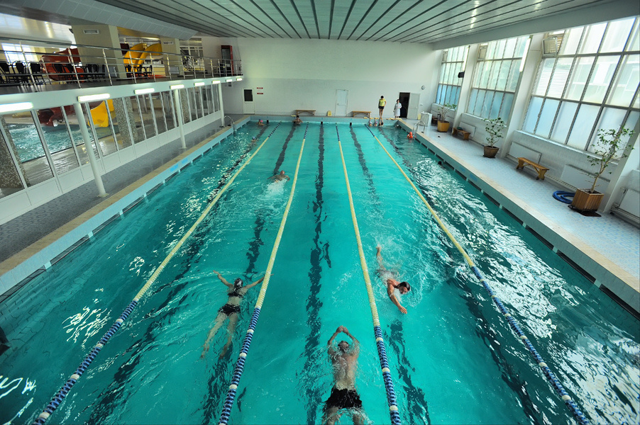
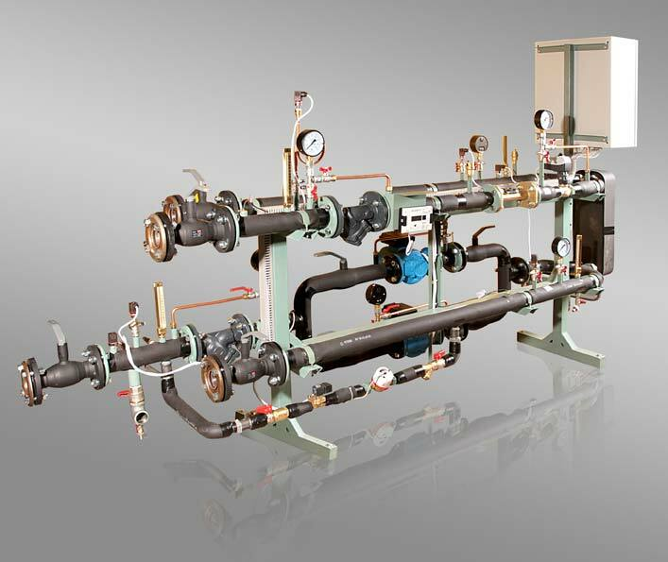



Reconstruction project of residential buildings, installation of Individual Heating Units

Slide 2

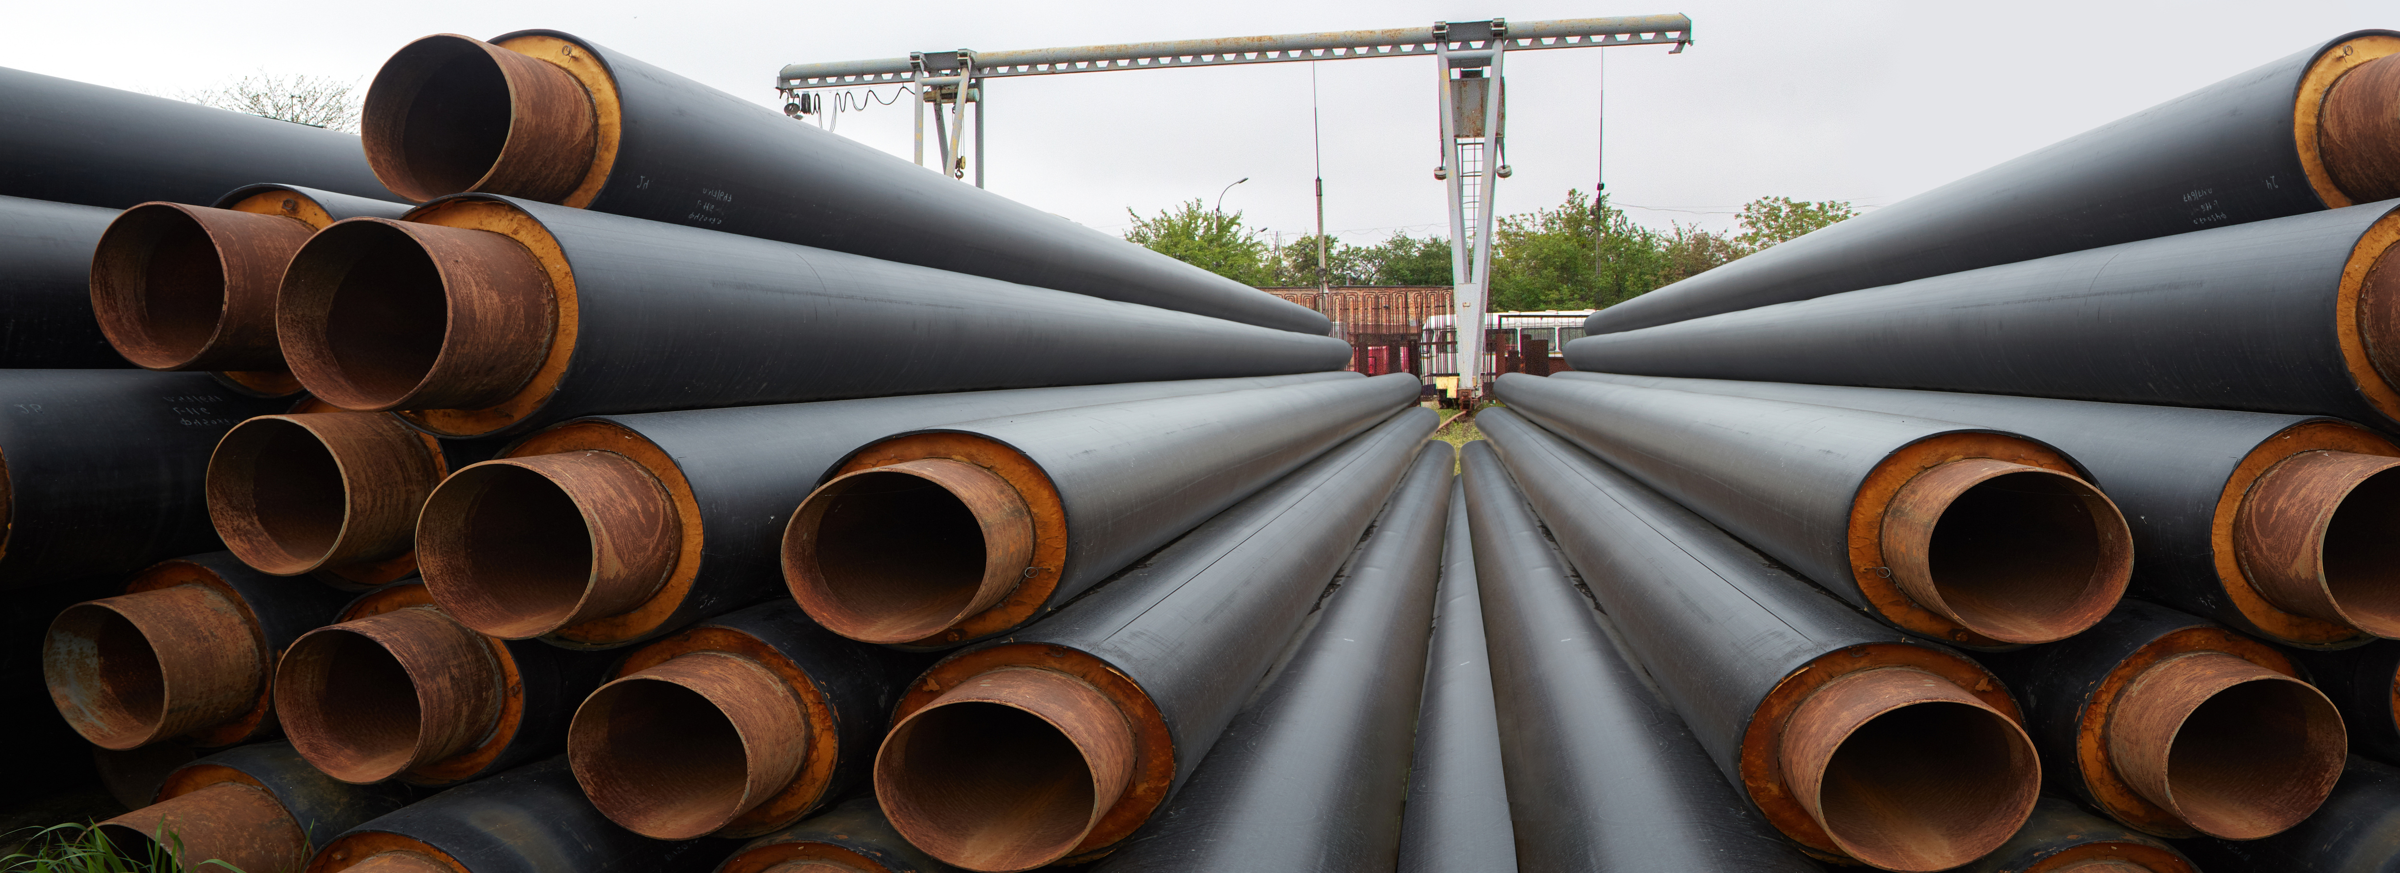






Reconstruction project of residential buildings, installation of Individual Heating Units
The project includes the following works:
purchase of equipment
installation of equipment
commissioning
heat output: from 0.3 to 0.7 Gcal
The number of IHUs that are planned to be installed is 156
The total cost of the project is
≈ 1 050 000 €

Slide 3




The implementation of the projects will allow to:
provide high-quality hot water supply services for the residents of Cherkasy during the off-heating period;
reduce environmental pollution;
reduce the use of fossil fuel and energy resources.

